Slide 1
Investigate Data Leakage Case
Keywords: Windows Registry, PC information, usage Account, Application Usage
Notes:
https://www.cfreds.nist.gov/data_leakage_case/data-leakage-case.html

Slide 2
Topics
Key concepts (image, volume, file system)
Gather basic PC information
User account investigation
Application usage investigation

Slide 3
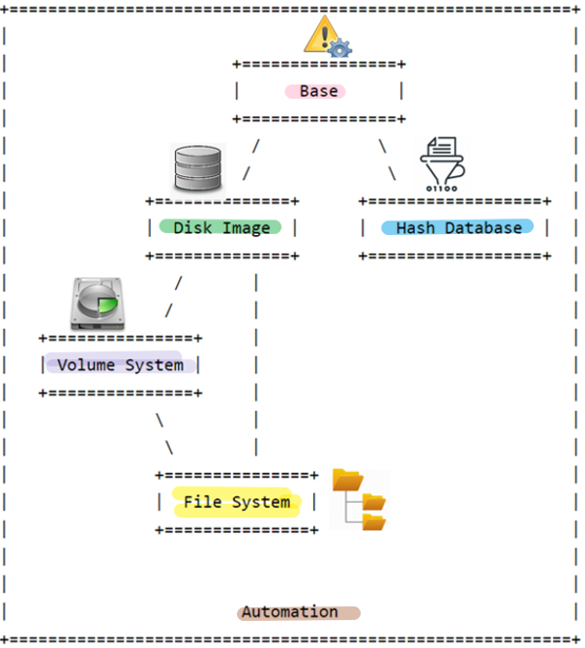
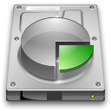
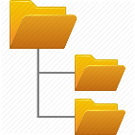
The Sleuth Kit (TSK Layers)
error handling, types, and convenience functions
Can open and process disk images in various formats
create an index of hashes and perform fast lookups of them
Processing data as a volume system, e.g., DOS partition tables
processing data as a file system, such as FAT or NTFS.
integrates all of the previous layers
Notes:
http://www.sleuthkit.org/sleuthkit/docs/api-docs/4.9.0/basicpage.html

Slide 4
Gather Basic PC Information

Slide 5
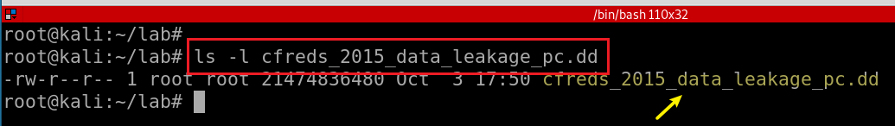
1. What are the hash values (MD5 & SHA-1) of the image? (Linux)
Verify you have the dd image

Slide 6
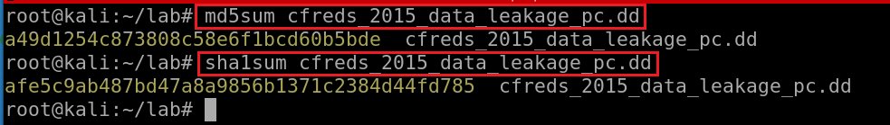
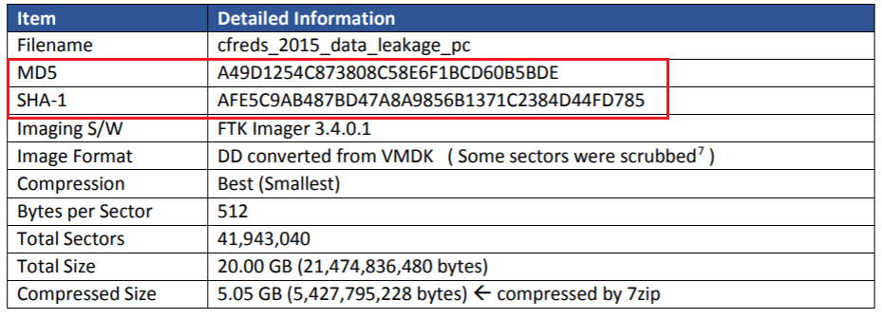
Compute MD5 and SHA1 of the DD image
Notes:
md5sum cfreds_2015_data_leakage_pc.dd
sha1sum cfreds_2015_data_leakage_pc.dd

Slide 7
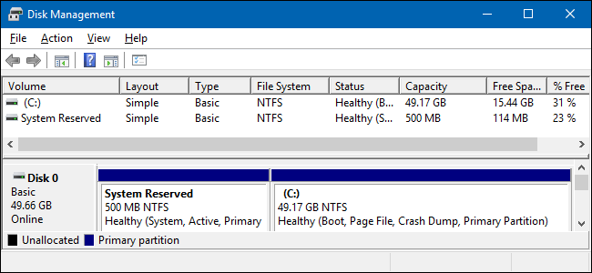
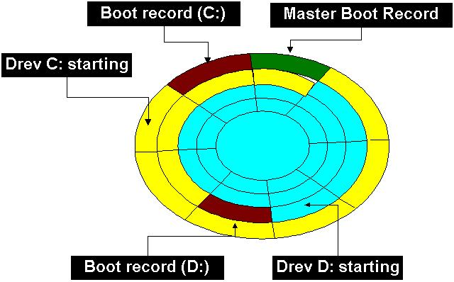
2.1 How to identify the partition information of PC image? (Method 1 -fdisk)
What is partition/volume?
Boot partition
boot loader and kernel files for OS to start up
OS folder: %systemroot%
System partition
contains system files and device drivers that are required for the operating system to function properly
hidden from the user
contains the file system (NTFS) driver, the hardware abstraction layer (HAL), and other important system files.

Slide 8
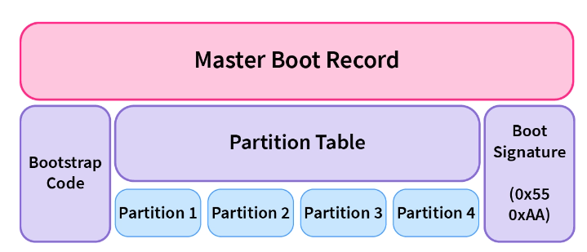
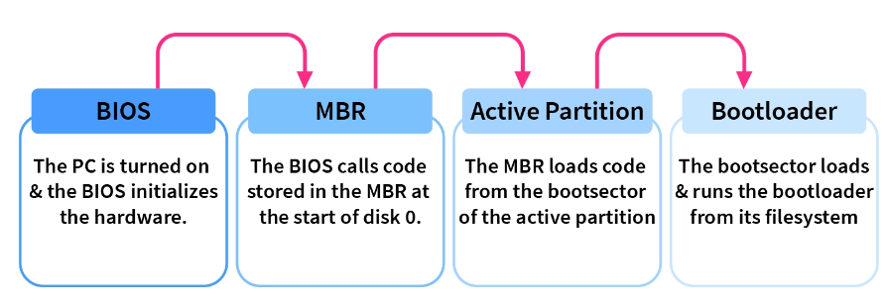
System Volume | Boot Volume
contains essential system files and configurations required for the initial booting process and system startup | the core operating system files are stored
includes boot files such as the Master Boot Record (MBR) or GUID Partition Table (GPT) | contains files like the Windows system files (e.g., in Windows environments) and program files.
essential for the operating system to locate and load the necessary files for booting. | is where the operating system continues to run once the boot process is complete.
 | the boot volume is assigned a drive letter (such as "C:" in Windows)
https://www.scaler.com/topics/operating-system/master-boot-record/

Slide 9
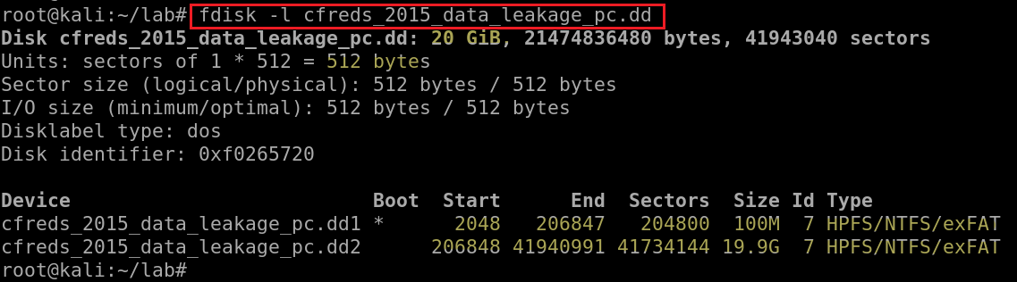
Since it is a file containing a copy of the entire disk, you can simply treat it like any other block device and run fdisk
Show partitions of the image
“Boot" volume: core os, load the remainder of an operating system
"system" volume: initial booting process and system startup
What is Block devices? hard drives, CD-ROM drives, RAM
What is fdisk ? Format disk
the device is bootable, not a boot partition
Notes:
http://blog.hakzone.info/posts-and-articles/linux/disk-analysis-with-fdisk-mmls-fsstat-and-fls/
Block devices are characterized by random access to data organized in fixed-size blocks. Examples of such devices are hard drives, CD-ROM drives, RAM disks, etc.
fdisk also known as format disk is a dialog-driven command in Linux used for creating and manipulating disk partition table. It is used for the view, create, delete, change, resize, copy and move partitions on a hard drive using the dialog-driven interface.

Slide 10
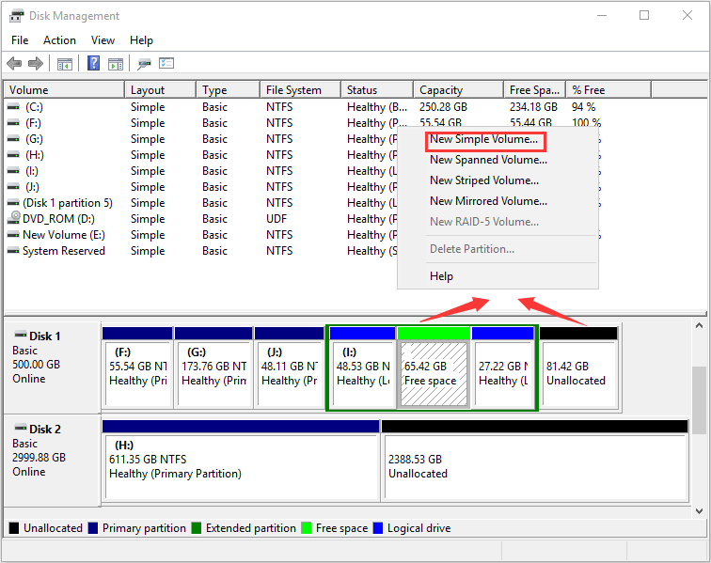
How to Identify the partition information of a PC image? (Method 2 -mmls)
What is Unallocated Space?
Any physical space on a hard drive that doesn't belong to a partition.
No programs can write to the space.
The space doesn't exist to the operating system.
To make use of unallocated space
you need to either create a new partition using the space or expand an existing partition.
Media management ls (mmls):
Can show unallocated sectors so it can be used to search for hidden data
Notes:
Similarly, the mmls tool can be used to display the partition layout of a volume system. However, mmls can be different by showing which sectors are not being used so that those can be searched for hidden data. In addition, mmls display info in sectors by default and if no options are used to filter the result then all volumes will be listed.

Slide 11
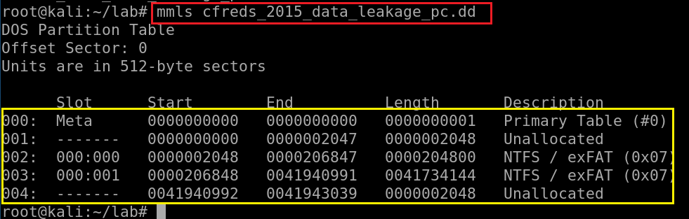
Show partitions and unallocated space using mmls
media management ls (mmls): Can show unallocated sectors so it can be used to search for hidden data
MBR

Slide 12
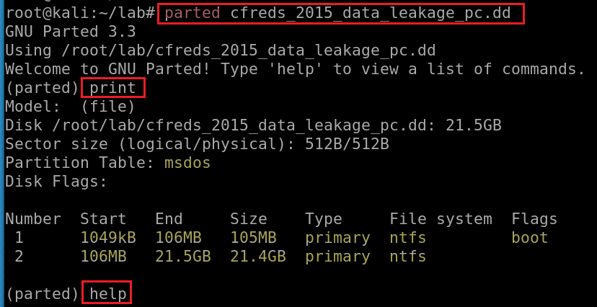
How to Identify the partition information of PC image? (Method 3 -parted)
do not list partitions whose size is greater than 2 TB
Notes:
Similarly, the mmls tool can be used to display the partition layout of a volume system. However, mmls can be different by showing which sectors are not being used so that those can be searched for hidden data. In addition, mmls display info in sectors by default and if no options are used to filter the result then all volumes will be listed.

Slide 13
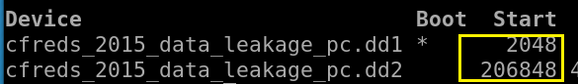
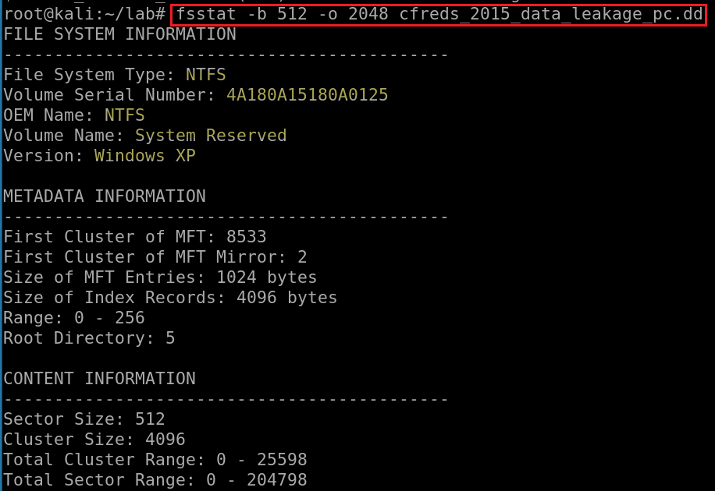
Display file system statistics and metadata information from a disk image (first partition)
-b: block size (default is 512)
-o: image offset
Notes:
fsstat -b 512 -o 2048 cfreds_2015_data_leakage_pc.dd

Slide 14
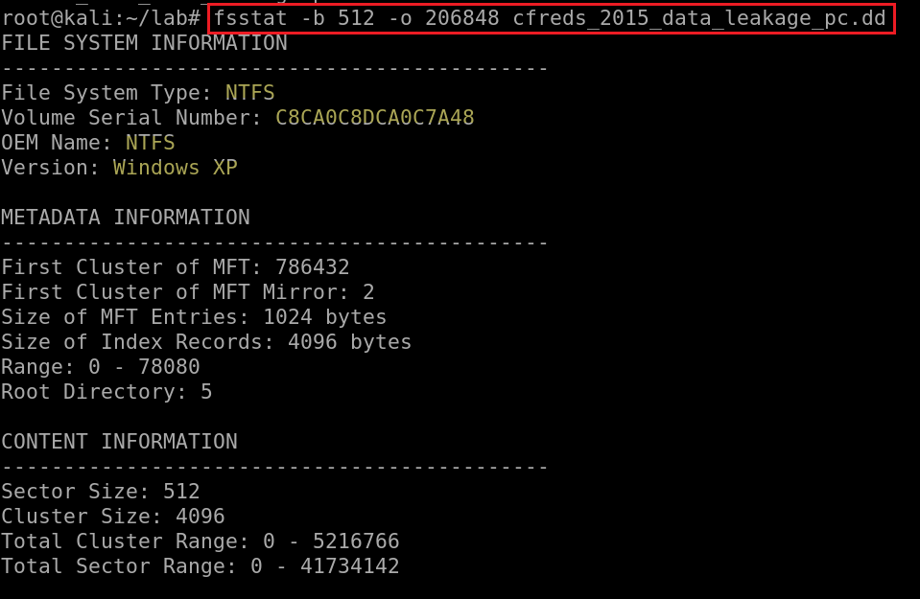
List the second partition details
-b: block size
-o: image offset
Serial number. Remember the #. We will use it later.
Notes:
fsstat -b 512 -o 206848 cfreds_2015_data_leakage_pc.dd

Slide 15
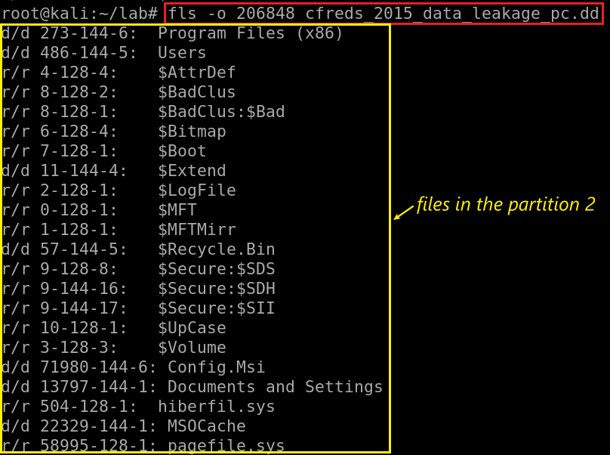
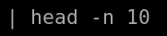
2.2 How to show files (directories) in 2nd partition?
Use head/tail command to limit the number of files to display
fls: List file and directory names in a disk image
File Type | Metadata Address | File Name
Notes:
fls -o 206848 cfreds_2015_data_leakage_pc.dd
The '-l' argument causes the "long" format with more details.
file type as reported in file name and metadata structure (see above)
Metadata Address
name
mtime (last modified time, change content)
atime (last accessed time)
ctime (last changed time)
crtime (created time)
size (in bytes)
uid (User ID)
gid (Group ID)
https://wiki.sleuthkit.org/index.php?title=Fls#-l_format

Slide 16
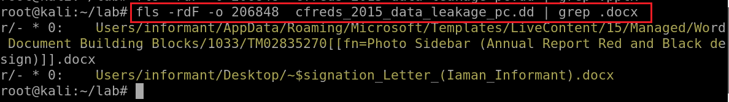
2.3 How to list all deleted .docx files in the whole partition?
. means "any character" in a regex.
for literal string: “\.docx”
Other useful parameters
-d display deleted entries only -D directories only -r recursively display directories
-l long format
-F Display file (all non-directory) entries only
-u Display undeleted entries only
Notes:
https://syang.io/2015/01/30/Sleuth-Kit-05.html
fls -rdF -o 206848 cfreds_2015_data_leakage_pc.dd
In GNU’s implementation of grep there is no functional difference between the basic and extended regular expression syntaxes. The only difference is that in basic regular expressions the meta-characters ?, +, {, |, (, and ) are interpreted as literal characters. To keep the meta-characters' special meanings when using basic regular expressions, the characters must be escaped with a backslash (\). We will explain the meaning of these and other meta-characters later.
https://linuxize.com/post/regular-expressions-in-grep/

Slide 17
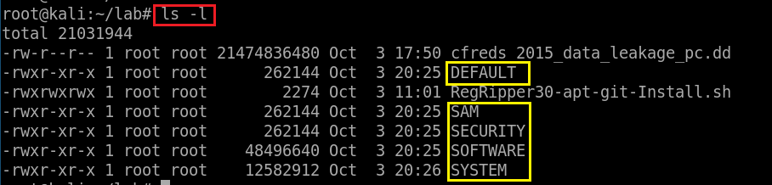
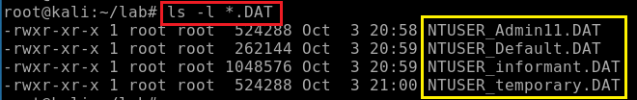
Verify system information
Verify Users’ information

Slide 18

Windows Registry Analysis Requirements
All investigations involving Windows Registry requires
Installed RegRipper 3.0
Extracted files contain PC’s registry information
Please follow the pptx to meet requirements
Verify files on the next slide before any tasks
Notes:
https://raw.githubusercontent.com/siftgrab/siftgrab/master/regripper.conf/RegRipper30-apt-git-Install.sh
https://medium.com/@stdout_/installing-regripper-v2-8-on-ubuntu-26dc8bc8a2d3
https://github.com/keydet89/RegRipper3.0

Slide 19
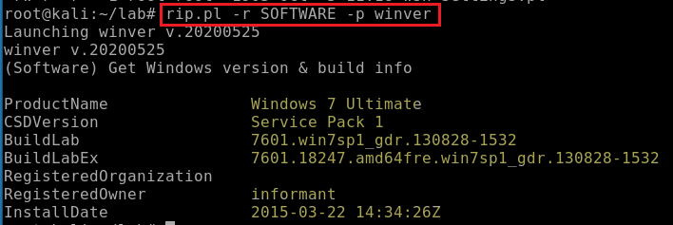
3. What is the installed OS information in detail?
-r: registry hive file to parse
-p: plugin
(GMT)
HKLM\SOFTWARE\Microsoft\Windows NT\CurrentVersion

Slide 20
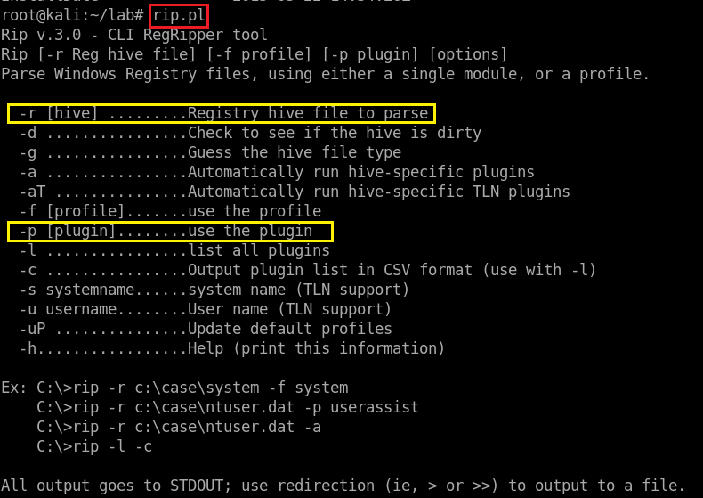
Show rip.pl command help
Try it

Slide 21
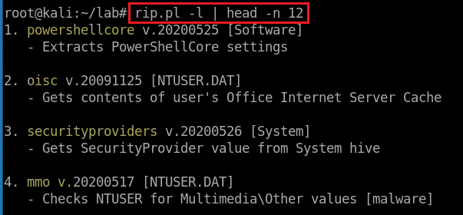
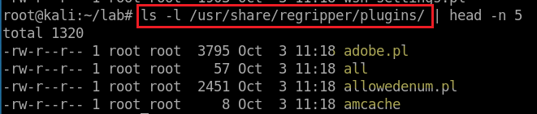
List all 243 plugins of SOFTWARE
-l: list
Show the location of all plugins
Notes:
whereis rip.pl
-b parameter to show just the binary:

Slide 22
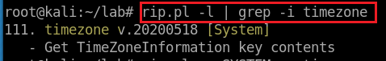
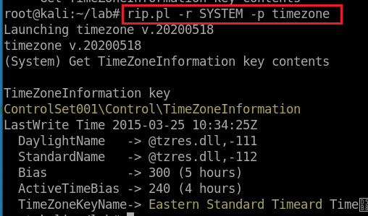
4. What is the time zone setting?
Search for timezone plugin and the file that contains timezone
Run timezone plugin
The Bias property represents the difference in minutes between Greenwich Mean Time (GMT—also known as Coordinated Universal Time, or UTC) and local time. For example, Eastern time (US and Canada) has a Bias property value of -300.
'Z' stands for Zulu time, which is also GMT and UTC.
HKLM\SYSTEM\ControlSet###\Control\TimeZoneInformation

Slide 23
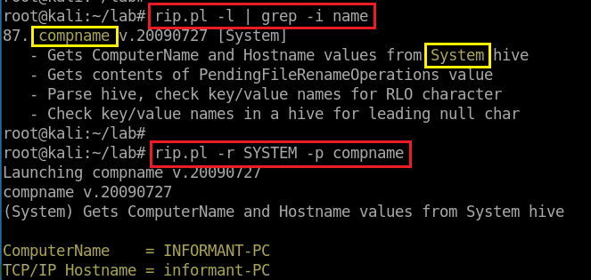
5. What is the computer name?
Search for computer name plugin and the file that contains timezone
Run compname plugin
HKLM\SYSTEM\ControlSet###\Control\ComputerName\ComputerName (value: ComputerName)
HKLM\SYSTEM\ControlSet###\Services\Tcpip\Parameters (value: Hostname)......

Slide 24
User Account Investigation

Slide 25
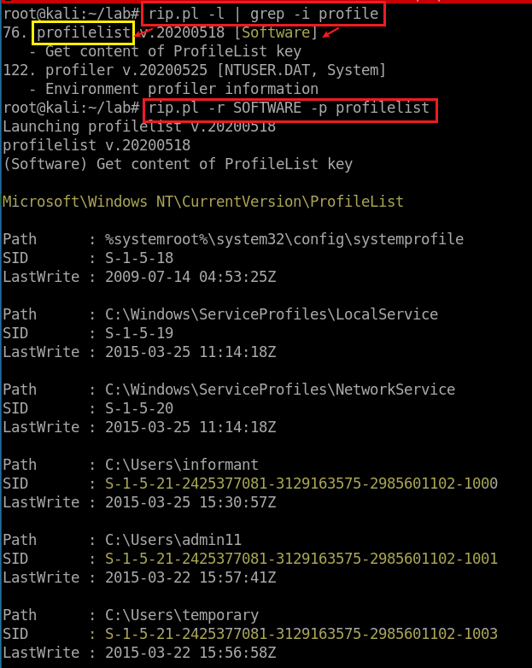
6. How many accounts does the system have? (except Administrator, Guest, systemprofile, LocalService, NetworkService)
Search for profiles
resolve SIDs to user

Slide 26
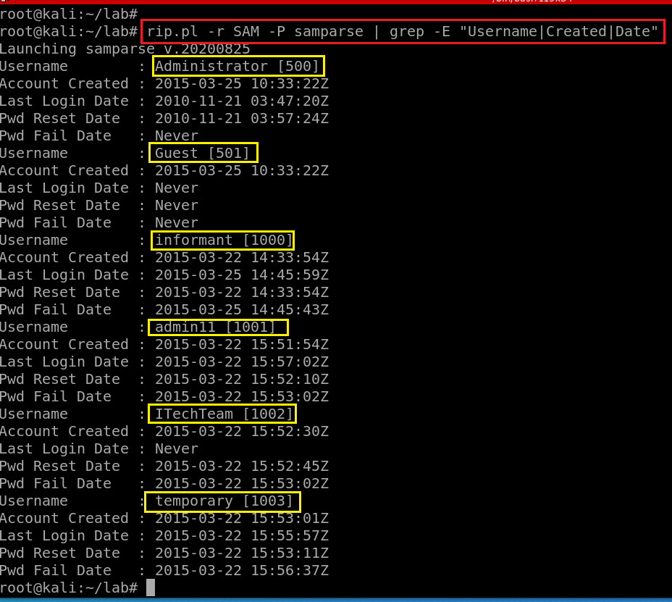
Find and search for Security Accounts Manager (SAM) information
SAM stores accounts information, e.g., passwords in a hashed format (NTLM).
grep –E <regular expression>
login created
last login: 3 days later but failed
Notes:
rip.pl -r SAM -P samparse | grep -E "Username|Created|Date"

Slide 27
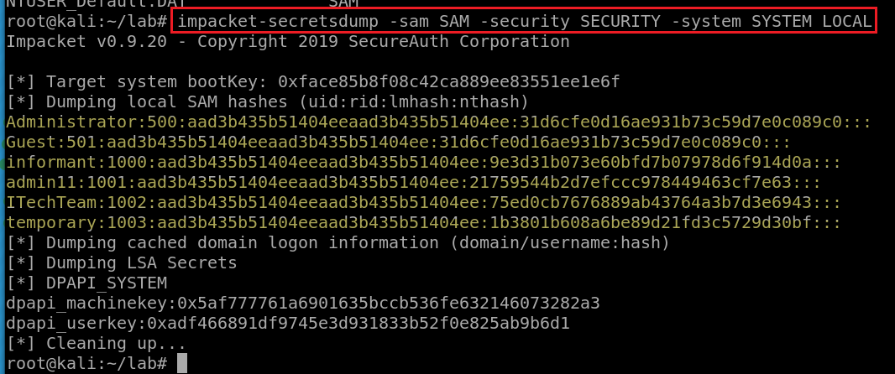
6.1 What are the NTLM of these accounts?
Notes:
https://pentestlab.blog/tag/lsa/#:~:text=LSA%20Secrets%20is%20a%20registry,host%2C%20local%20security%20policy%20etc.&text=Registry%20keys%20of%20interest%20are,as%20they%20contain%20password%20hashes.

Slide 28
6.2 How to Crack Windows 10 passwords?
Crack Win 10 password using NTLM and Rainbow table. Follow the PPTs

Slide 29
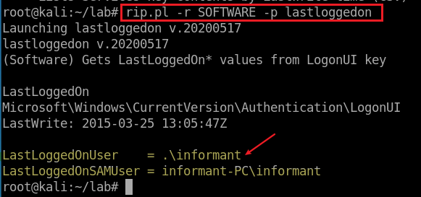
7. Who was the last user to logon into PC?
successfully logged in
HKLM\Software\~
HKLM\SAM\~

Slide 30
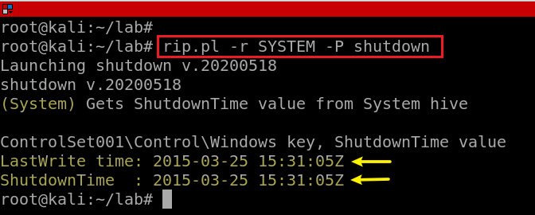
8. When was the last recorded shutdown date/time?
A control set contains system configuration information such as device drivers and services.
ControlSet001 may be the last control set you booted with.
ControlSet002 could be what is known as the last known good control set, or the control set that last successfully booted Windows NT.
HKLM\SYSTEM\ControlSet###\Control\Windows (value: ShutdownTime)
Conclusion: informant was the last one logged on at 13:05 (previous slide) and shut down the PC at 15:31pm
Notes:
rip.pl -r SYSTEM -P shutdown

Slide 31
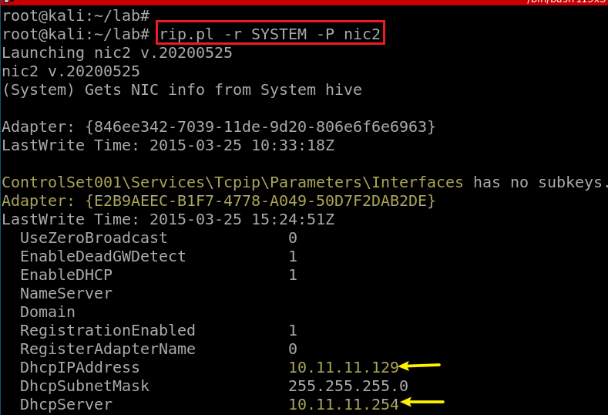
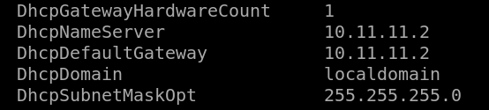
9. Explain the information of network interface(s) with an IP address assigned by DHCP.
HKLM\SYSTEM\ControlSet###\Services\Tcpip\Parameters\Interfaces\{GUID}
Notes:
rip.pl -r SYSTEM -P nic2

Slide 32
Application Usages Investigation

Slide 33
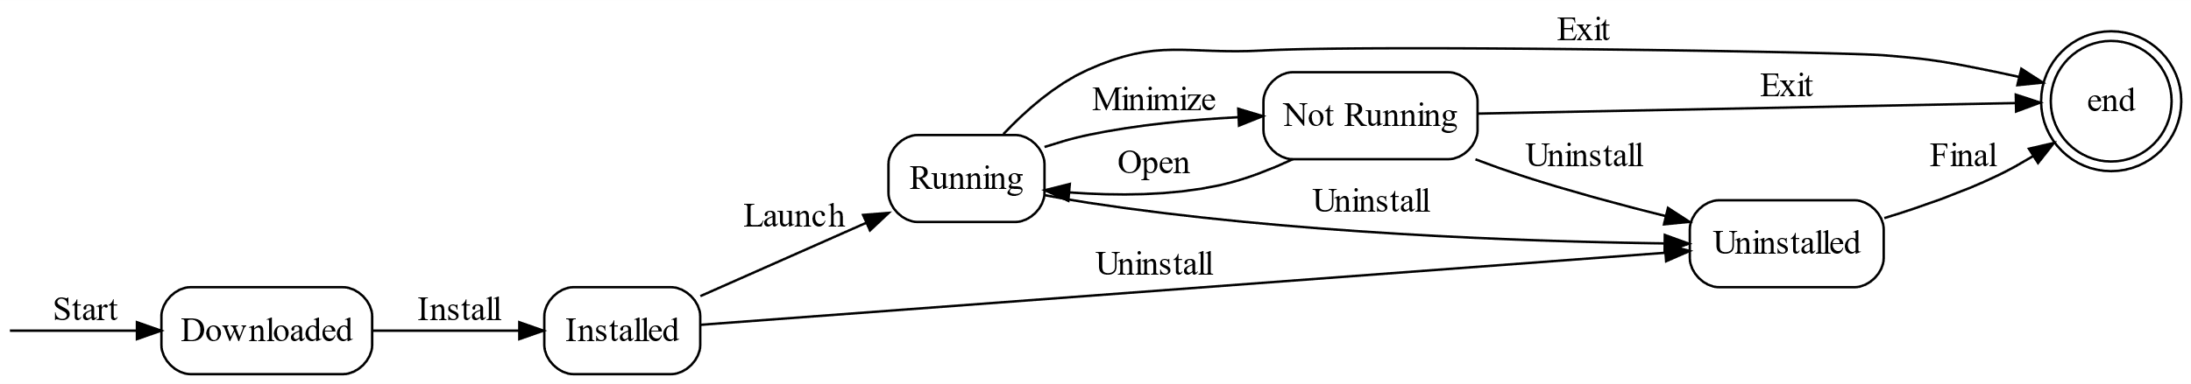
A state diagram for application usage investigations
Notes:
digraph ApplicationStates {
node [shape=box, style=rounded];
// Define the application states
Downloaded [label="Downloaded"];
Installed [label="Installed"];
Running [label="Running"];
NotRunning [label="Not Running"];
Uninstalled [label="Uninstalled"];
// Define transitions between states
Downloaded -> Installed [label="Install"];
Installed -> Running [label="Launch"];
Running -> NotRunning [label="Minimize"];
Running -> Uninstalled [label="Uninstall"];
NotRunning -> Running [label="Open"];
NotRunning -> Uninstalled [label="Uninstall"];
Installed -> Uninstalled [label="Uninstall"];
// Define initial and final states
start [shape=point, width=0];
end [shape=doublecircle];
// Define initial and final state transitions
start -> Downloaded [label="Start"];
Running -> end [label="Exit"];
NotRunning -> end [label="Exit"];
Uninstalled -> end [label="Final"];
}

Slide 34
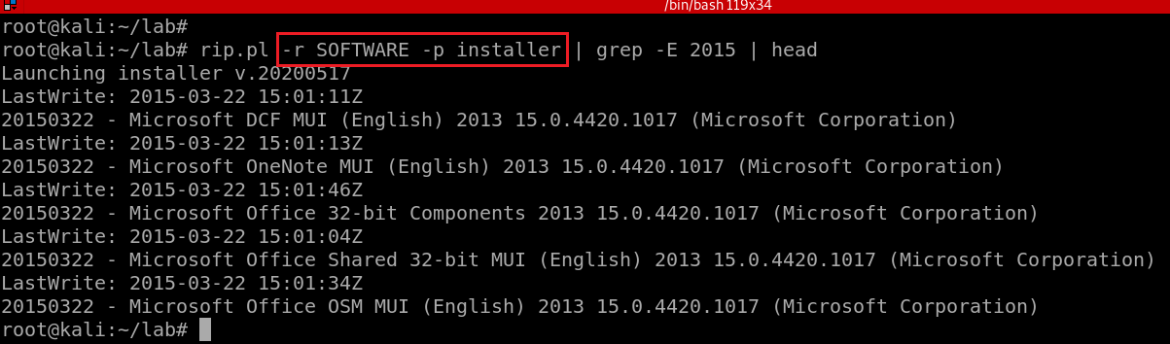
10. What applications were installed by the suspect after installing OS?
HKLM\SOFTWARE\Microsoft\Windows\CurrentVersion\Installer\UserData

Slide 35
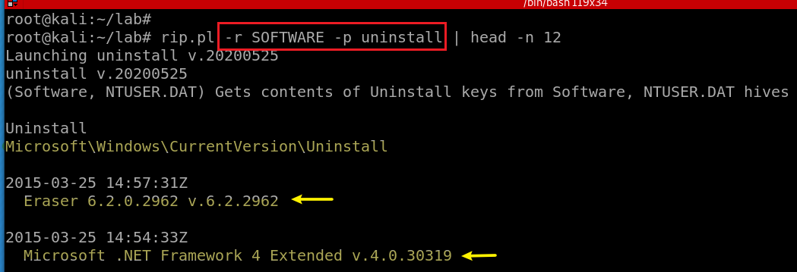
10.1 What applications can be uninstalled by the suspect after installing OS?
HKLM\SOFTWARE\Microsoft\Windows\CurrentVersion\Uninstall\~
HKLM\SOFTWARE\Wow6432Node\Microsoft\Windows\CurrentVersion\Uninstall\~
Notes:
rip.pl -r SOFTWARE -p uninstall | head -n 12

Slide 36
11. List application execution logs (Executable path, execution time, execution count...)
Shimcache: speed loading
Amcache/RecentFileCache
UserAssist
Prefetch
MuiCache: Multilingual User Interface

Slide 37
11.1 Primary purpose of Shimcache
The primary goal is to optimize program loading
speed up loading frequently executed programs by caching information about them.
Shimcach records execution history
program names, file paths, timestamps, and execution counts.
NOT serving as a dedicated compatibility checker.
it is closely tied to Windows' compatibility features.
when a program is launched, the Shimcache checks if there are any known compatibility fixes or "shims" associated with that program.
shims are applied to ensure the program runs smoothly on the Windows platform.
not fix compatibility issues

Slide 38
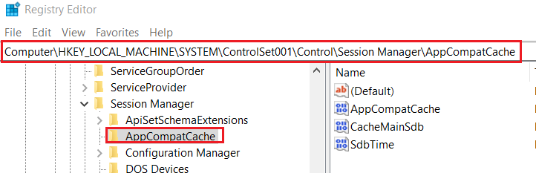
Registry for Shimcache
Known as AppCompatCache
HKLM\SYSTEM\ControlSet###\Control\Session Manager\AppCompatCache\
Two actions that can cause the Shimcache to record an entry
A file is executed.
This is recorded on all versions of Windows beginning with XP.
A user interactively browses a directory
if a directory contains the files “foo.txt” and “bar.exe”, a Windows 7 system may record entries for these two files in the Shimcache.
On Windows Vista, 7, Server 2008, and Server 2012
Notes:
https://www.fireeye.com/blog/threat-research/2015/06/caching_out_the_val.html#:~:text=These%20Application%20Compatibility%20Cache%20(%E2%80%9CShimcache,compatibility%20issues%20with%20executed%20programs.

Slide 39
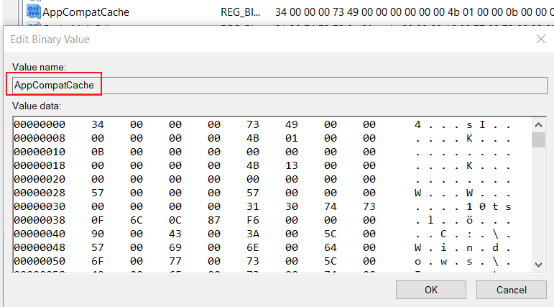
Shimcache entry
Stores various file metadata depending on the operating system
File Full Path
File Size
$Standard_Information (SI) Last Modified time
Shimcache Last Updated time
Process Execution Flag : set this flag during process creation/execution
Only contains the information prior to the system’s last startup
current entries are stored only in memory
The oldest data is replaced by new entries.
Notes:
https://www.fireeye.com/blog/threat-research/2015/06/caching_out_the_val.html#:~:text=These%20Application%20Compatibility%20Cache%20(%E2%80%9CShimcache,compatibility%20issues%20with%20executed%20programs.
https://lifars.com/wp-content/uploads/2017/03/Technical_tool_Amcache_Shimcache.pdf

Slide 40
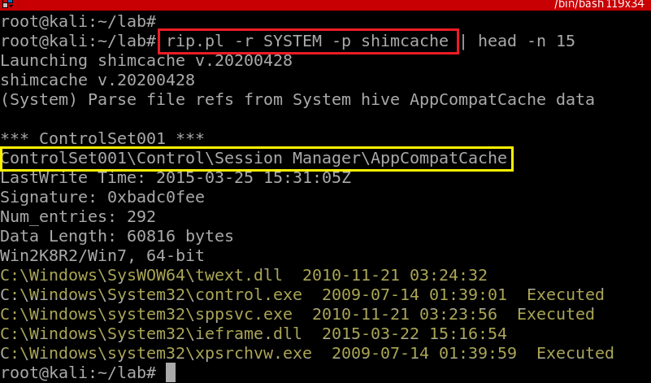
Extract shimcache from registry
Notes:
rip.pl -r SYSTEM -p shimcache
\documentclass{article}
\usepackage{geometry}
\usepackage{array}
\usepackage{multirow}
\usepackage{caption}
\geometry{a4paper, total={6in, 8in}}
\begin{document}
\begin{table}[h]
\centering
\caption{Comparison of Amcache and Shimcache}
\label{tab:comparison}
\begin{tabular}{|p{3cm}|p{6cm}|p{6cm}|}
\hline
\textbf{Aspect} & \textbf{Amcache} & \textbf{Shimcache} \\
\hline
Purpose & Application compatibility cache, records information about installed applications for compatibility testing & Speeds up loading of frequently executed executables by recording execution history \\
\hline
Location & Stored in the Windows Registry as "Amcache.hve" & Stored in the Windows Registry as a key within "AppCompatCache" \\
\hline
Data & Contains information about installed applications, including file paths, version numbers, and compatibility details & Contains information about recently executed programs, including file paths, timestamps, and execution counts \\
\hline
Update Frequency & Updated periodically, especially when software changes occur on the system (e.g., application installations or updates) & Updated each time an executable is run \\
\hline
Use Cases & Often used for application inventory and compatibility testing & Frequently used in forensic investigations to determine which programs were executed on a Windows system and when they were last run \\
\hline
\end{tabular}
\end{table}
\end{document}

Slide 41
11.2 Main purpose of Amcache
Assist with application compatibility (Application Compatibility Cache)
ensure that software updates or system changes do not break existing applications
used to apply compatibility fixes or "shims" to programs
maintain information about installed applications on the system.
including file paths, version numbers, and compatibility settings.
Software Inventory
a repository of information about installed software.
C:\Windows\AppCompat\Programs\Amcache.hve
Focus on software installation and updates
ShimCache entry is updated each time the application is executed
Notes:
https://www.ssi.gouv.fr/uploads/2019/01/anssi-coriin_2019-analysis_amcache.pdf
http://journeyintoir.blogspot.com/2013/12/revealing-recentfilecachebcf-file.html

Slide 42
Amcache replaces RecentFileCache.bcf
Amcache
Windows 8 and Later
It includes information about executed programs (similar to Shimcache) and also contains details about recently accessed files and folders
RecentFileCache.bcf
In Windows 7 and earlier versions, the RecentFileCache.bcf file was used to record recent file activity.
Notes:
https://www.ssi.gouv.fr/uploads/2019/01/anssi-coriin_2019-analysis_amcache.pdf
http://journeyintoir.blogspot.com/2013/12/revealing-recentfilecachebcf-file.html

Slide 43
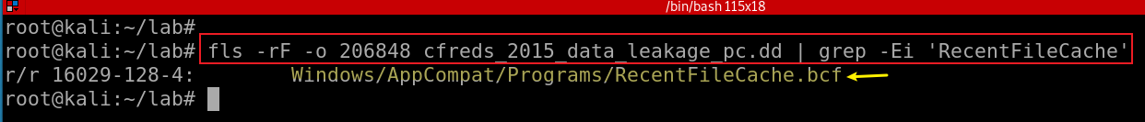
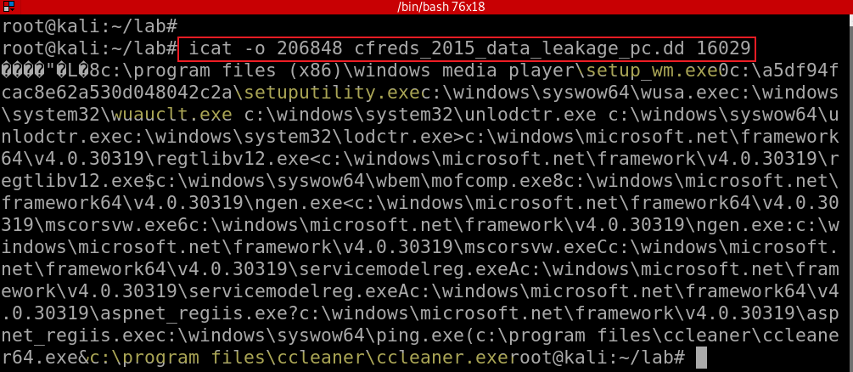
Find the location of RecenfFileCache.bcf (Win 7) rip.pl –r Amcache.hve –p amcache (Win 8)
Show RecenfFileCache.bcf
Notes:
fls -rF -o 206848 cfreds_2015_data_leakage_pc.dd | grep -Ei 'RecentFileCache‘
icat -o 206848 cfreds_2015_data_leakage_pc.dd 16029

Slide 44
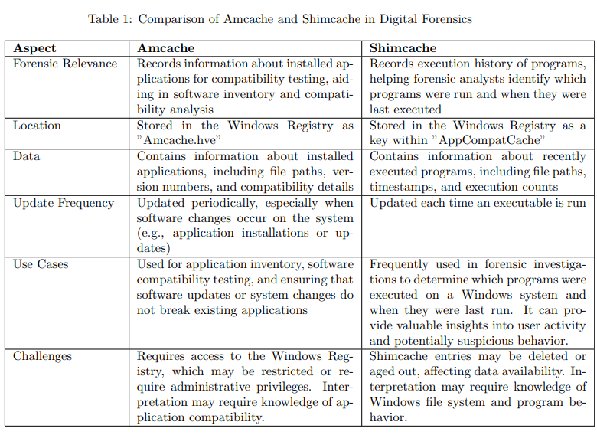
Notes:
\documentclass{article}
\usepackage{geometry}
\usepackage{array}
\usepackage{caption}
\geometry{a4paper, total={6in, 8in}}
\begin{document}
\begin{table}[h]
\centering
\caption{Comparison of Amcache and Shimcache in Digital Forensics}
\label{tab:comparison}
\begin{tabular}{|p{3cm}|p{6cm}|p{6cm}|}
\hline
\textbf{Aspect} & \textbf{Amcache} & \textbf{Shimcache} \\
\hline
Forensic Relevance & Records information about installed applications for compatibility testing, aiding in software inventory and compatibility analysis & Records execution history of programs, helping forensic analysts identify which programs were run and when they were last executed \\
\hline
Location & Stored in the Windows Registry as "Amcache.hve" & Stored in the Windows Registry as a key within "AppCompatCache" \\
\hline
Data & Contains information about installed applications, including file paths, version numbers, and compatibility details & Contains information about recently executed programs, including file paths, timestamps, and execution counts \\
\hline
Update Frequency & Updated periodically, especially when software changes occur on the system (e.g., application installations or updates) & Updated each time an executable is run \\
\hline
Use Cases & Used for application inventory, software compatibility testing, and ensuring that software updates or system changes do not break existing applications & Frequently used in forensic investigations to determine which programs were executed on a Windows system and when they were last run. It can provide valuable insights into user activity and potentially suspicious behavior. \\
\hline
Challenges & Requires access to the Windows Registry, which may be restricted or require administrative privileges. Interpretation may require knowledge of application compatibility. & Shimcache entries may be deleted or aged out, affecting data availability. Interpretation may require knowledge of Windows file system and program behavior. \\
\hline
\end{tabular}
\end{table}
\end{document}

Slide 45
11.3 UserAssist
Microsoft uses UserAssist to populate a user’s start menu with frequently used applications.
Every GUI-based program launched from the desktop are tracked
These values are located in each user’s NTUSER.DAT
ROT-13 encoded.
Timestamp of last run
Count: HKCU\Software\Microsoft\Windows\CurrentVersion\Explorer\UserAssist\{GUID}\Count
Good to analyze the behaviors of users

Slide 46
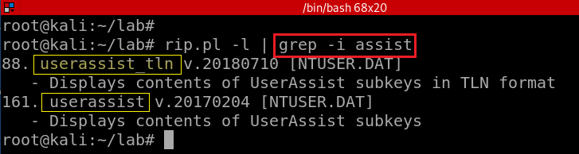

Slide 47
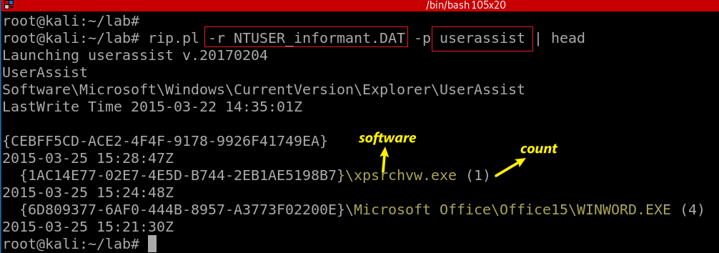
List executed programs by the user informant
Notes:
rip.pl -r NTUSER_informant.DAT -p userassist | head
https://www.andreafortuna.org/2018/05/23/forensic-artifacts-evidences-of-program-execution-on-windows-systems/

Slide 48
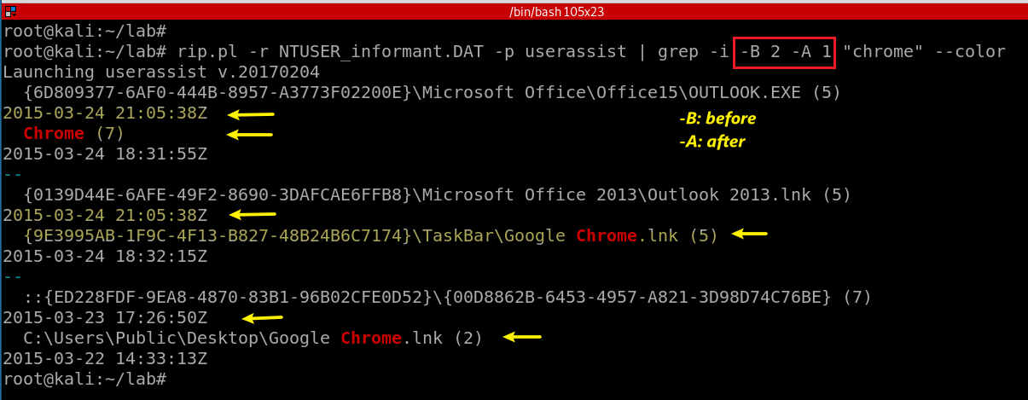
Search if “chrome” has been executed by the user informant. Show lines before and after the matches

Slide 49
11.4 Prefetch
A memory management technology
Save prefetch (executables) information in .pf
%SYSTEMROOT%\Prefetch\*.pf
To improve customer experience,
Introduced by Microsoft in Windows XP and Windows 2003 Server.
Preloads most frequently used software (with parameters) into memory
To speed the operating system booting and application launching.
SuperFetch On Windows Vista
An improved version of Prefetch
Notes:
https://countuponsecurity.com/2016/05/16/digital-forensics-prefetch-artifacts/

Slide 50
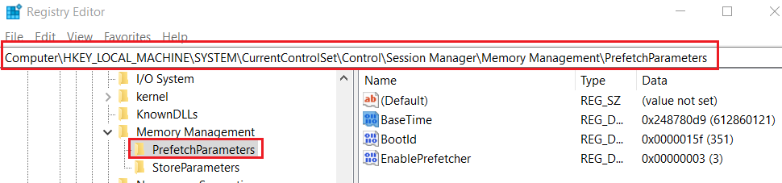
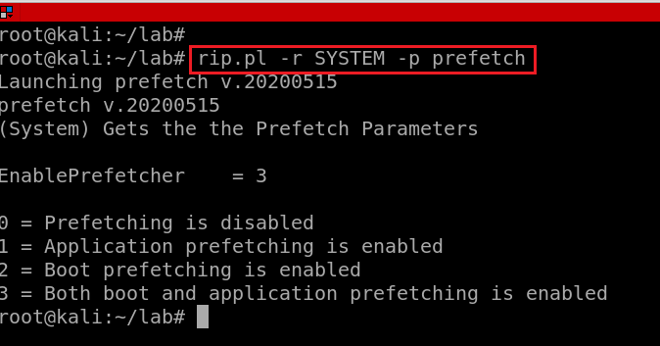
Prefetch registry configuration (enable/disable)
Exam prefetch setting from registry

Slide 51

Verify Prefetch folder has .pf files
Notes:
sudo apt-get install tree

Slide 52

Verify prefetch command

Slide 53

Parse Prefetch of chrome.exe
-f FILE, --file FILE Parse a given Prefetch file
Notes:
prefetch.py -f Prefetch/CHROME.EXE-D999B1BA.pf | more

Slide 54

Parse Prefetch of chrome.exe and save the results to .CSV
-c, --csv Present results in CSV format
Notes:
ls -l ../Prefetch/ | grep -i chrome
prefetch.py -f Prefetch/CHROME.EXE-D999B1BA.pf -c

Slide 55

Notes:
\documentclass{article}
\usepackage{geometry}
\usepackage{array}
\usepackage{caption}
\geometry{a4paper, total={6in, 8in}}
\begin{document}
\begin{table}[h]
\centering
\caption{Comparison of UserAssist and Prefetch in Digital Forensics}
\label{tab:comparison}
\begin{tabular}{|p{3cm}|p{6cm}|p{6cm}|}
\hline
\textbf{Aspect} & \textbf{UserAssist} & \textbf{Prefetch} \\
\hline
Forensic Relevance & Provides insights into user-specific program execution history, helping forensic analysts determine which programs were run by users & Offers information about frequently executed programs and their associated files, which can be useful for forensic investigations to understand program usage \\
\hline
Location & Registry-based, stored in the Windows Registry & File-based, stored in the `C:\Windows\Prefetch` directory \\
\hline
Data & Contains data about program execution, including program names, execution counts, and timestamps & Maintains data about frequently run executables, including file names, paths, and execution order \\
\hline
Update Frequency & Updated as programs are executed, reflecting user-specific program usage & Continuously updated as programs are run to optimize program loading \\
\hline
Use Cases & Used in forensic analysis to determine which programs were executed on a Windows system and when they were last run. It can provide evidence of user activity. & Used in forensic investigations to understand which programs were frequently run on a system, aiding in timeline analysis and identifying suspicious activity \\
\hline
Challenges & Requires access to the Windows Registry, which may be restricted or require administrative privileges. Analysis may require interpreting encoded program names. & Prefetch files may be deleted or missing, affecting data availability. Interpretation of Prefetch data may require knowledge of Windows file system and program behavior. \\
\hline
\end{tabular}
\end{table}
\end{document}

Slide 56
11.5 MuiCache: Multilingual User Interface
What is MUI
To support multiple language for software
Drawback
the MUI scheme is that it’s a bit slower
Solution: MUI caching for localized strings
When the right version of a string is retrieved from MUI file for a given app, it’s stored in the registry.
Then if the string is needed again, it can be retrieved from the registry, which is faster than having to open up the MUI file again.

Slide 57

Windows 2000, Windows XP, Windows Server 2003: HKEY_CURRENT_USER\Software\Microsoft\Windows\ShellNoRoam\MUICache.
Windows 10:

Slide 58


Search for muicache plugin
Exam muicache

Slide 59

Search usrclass.dat
Notes:
fls -rF -o 206848 cfreds_2015_data_leakage_pc.dd | grep -i usrclass.dat

Slide 60


Extract usrclass.dat
Search muicache from usrclass.dat
Notes:
icat -o 206848 cfreds_2015_data_leakage_pc.dd 70107 > usrclass_informant.dat
rip.pl -r usrclass_informant.dat -p muicache

Slide 61
Summary of 11.
[File] Windows Prefetch folder \Windows\Prefetch\*.pf Executable file paths and their execution timestamps (+ execution counts)
[File] IconCache \Users\informant\AppData\Local\IconCache.db Executable file paths and their icon images
[Reg] UserAssist HKU\informant\Software\Microsoft\Windows\CurrentVersion\Explorer\UserAssist\*\Count\ Executable file paths and their execution timestamps (+ execution counts)
[Reg] Application Compatibility (Shimcache) HKLM\SYSTEM\ControlSet###\Control\Session Manager\AppCompatCache\ Executable file paths and their modified timestamps
[Reg] Application Compatibility Cache HKU\informant\Software\Microsoft\Windows NT\CurrentVersion\AppCompatFlags\Compatibility Assistant\ Executable file paths and their modified timestamps
[Reg] MuiCache HKU\informant\Software\Classes\Local Settings\Software\Microsoft\Windows\Shell\MuiCache\ Executable file paths

